Slide 1
A8024 Product Realization
VARDHAMAN COLLEGE OF ENGINEERING, HYDERABAD
Autonomous institute, affiliated to JNTUH
Product Realization Review -2
Team No. - 6
TOGOTU
(To Go To Tour)
By
22881A66D1 - A.Abhinay
22881A66D6 - B.Sai pranathi
22881A66E1 - D.Srithan
22881A66E9 - J.Venkatesh
22881A66F2 - K.Thirupathi
Under the guidance of
Dr. C Padmini

Slide 2
A8024 - Product Realization
Outline:
Introduction
Need statement and Community Partner details
Components Used
Conceptualization
Construction and working of Product
Picture of the Product
Video link
Conclusion
References

Slide 3


A8024 - Product Realization
Introduction:
Tourism is travel for pleasure or business; it brings significant economic potential to destinations looking to develop their tourism industry, including employment opportunities, tax revenue, and currency exchange benefits.
Tourism, whether for fun or business, can greatly benefit a destination's economy by creating jobs, generating tax income, and boosting foreign exchange.
Tourism drives infrastructure improvements, enhancing transportation, public services, and amenities, benefiting both visitors and local communities, and attracting further investment.

Slide 4

A8024 - Product Realization
Factors that Motivate People to Travel
To spend holidays leisurely
To visit friends and relatives
To attend business and professional engagements
To get health treatment
To undertake religious pilgrimages
To seek adventure and exploration
To delve into cultural and historical interests
To indulge in culinary experiences
To find relaxation and wellness
To pursue education and learning opportunities

Slide 5
A8024 - Product Realization
Need Statement :
A TourGuide app will connect travelers with local guides for personalized assistance and authentic experiences. It will help local communities by creating job opportunities and promoting sustainable tourism, providing tourists with insights into local culture, events, and food.
Community Partner details:
Collaborating with local guides and organizations empowers community members by creating employment opportunities and fostering cultural and food exchanges. This ensures memorable and responsible journeys while encouraging sustainable tourism practices, paving the way for long-term economic growth and cultural preservation.

Slide 6
A8024 - Product Realization
Components Used :
Android Studio:
Android Studio stands as the premier integrated development environment (IDE) for Android app creation. It provides a robust suite of tools that streamline the development, testing, and deployment of Android applications, empowering developers with a comprehensive platform.
XML Layout Designing:
XML layout, a cornerstone of Android development, serves as a structured markup language defining the arrangement and appearance of user interfaces. It acts as a blueprint, specifying properties and enabling the creation of intuitive, visually appealing app layouts that enhance user experience.
Maps and Navigation:
Maps and navigation are crucial for directing users to attractions, restaurants, and hotels. APIs like Google Maps offer seamless online and offline route planning, enhancing usability with real-time directions and location details for optimal navigation.

Slide 7
A8024 - Product Realization
Components Used:
Multimedia Integration:
Enhance your app with image and video galleries featuring landmarks and cultural sites. Provide multimedia content for a deeper understanding of locales. Consider adding audio guides for narrated insights, offering users a comprehensive and immersive experience.
Social Features:
Promote community interaction by allowing users to share travel experiences and recommendations on social media. Enable user profiles, favorite place saving, and itinerary sharing within the app to foster community engagement and enhance user involvement.
Object-Oriented Programming :
Object-Oriented Programming (OOP) is a foundational paradigm in software development, centered around objects (instances of classes) that encapsulate data and behavior. OOP's principles—encapsulation, inheritance, polymorphism, and abstraction—promote structured, modular code design that mirrors real-world entities, fostering code reusability, scalability, and maintenance efficiency.

Slide 8
Conceptualization:
Integration with Social Media
User Registration and Profile Creation
Key Features of Tour Guide Mobile Application
Customer Support
Tour Listings
Notifications
Tour Guide Profiles
Real-time Communication

Slide 9
A8024 - Product Realization
Construction of Product :
Step 1: Defining Purpose
Objective: Provide users with a comprehensive tour guide experience.
Features: Information on tourist spots, maps, navigation, audio guides, reviews, and booking options
Step 2: Planinng Features
User Interface (UI):
Home Screen: Overview of the app.
Search: Find places or tours.
Map: Interactive map with locations.
Details: Information about specific spots.
Profile: User account and preferences
Step 3: Designing the UI
Use tools like Figma or Sketch to create mockups of your screens.
Ensure it's user-friendly and visually appealing.

Slide 10
Step 4: Developing the Frontend
Technology: HTML, CSS, JavaScript, React (for a web app), or Swift/Kotlin (for mobile apps)
Step 5: Developing the Backend
Technology: Node.js, Express.js (or Django, Flask for Python).
Step 6: Integrating Services
Maps: Use Google Maps API for location services.
Payments: Integrate payment gateways (Stripe, PayPal) for bookings.
Notifications: Push notifications for updates (Firebase)
Step 8: Deployment
Mobile App: Publish on App Store (iOS) and Google Play Store (Android)
Step 9: Maintain and Update
Regularly update the app with new features and improvements based on user feedback.
Ensure security updates are applied promptly

Slide 11
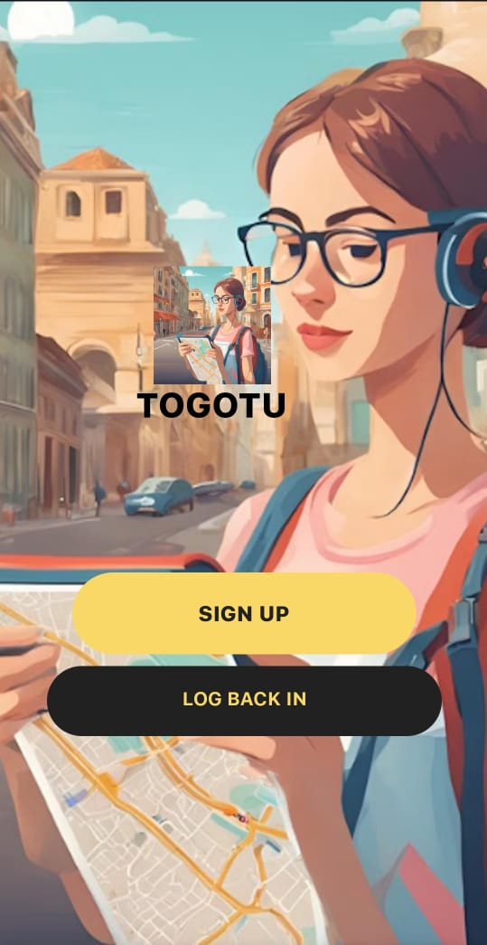
A8024 - Product Realization
Working of Product :
Togotu enhances travel with local guides, available on Android and iOS, enriching journeys with destination insights and seamless experiences.
Togotu offers personalized packing advice for every destination, ensuring travelers are well-prepared and can enjoy their trip fully.
Togotu provides insights on sightseeing, certified hotels, and top accommodations for enriching and memorable travel experiences.
Togotu ensures travelers embark confidently, offering reliable guidance and essential information for unforgettable solo, family, or romantic journeys.

Slide 12


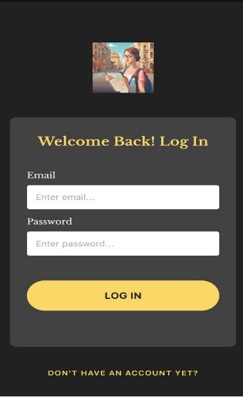
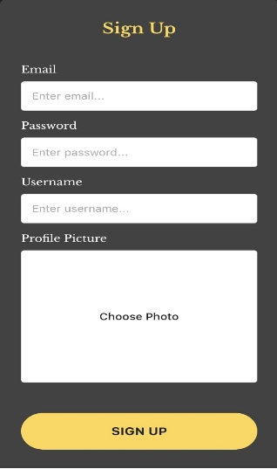
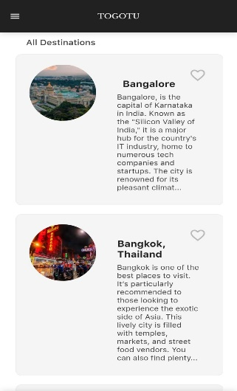
A8024 - Product Realization
Picture of the Product:

Slide 13
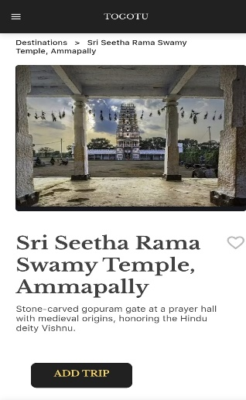
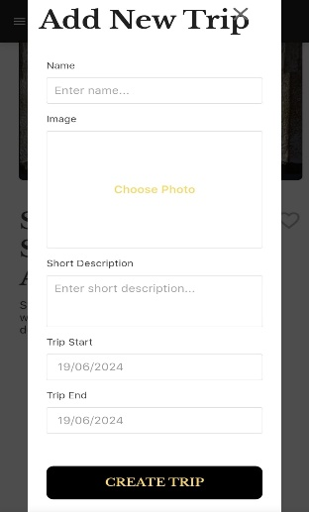
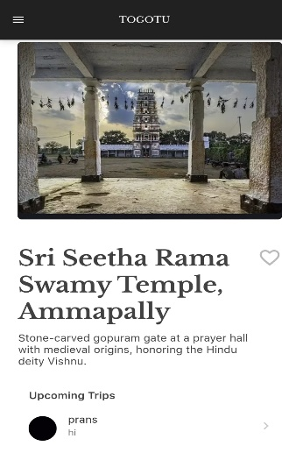
A8024 - Product Realization

Slide 14
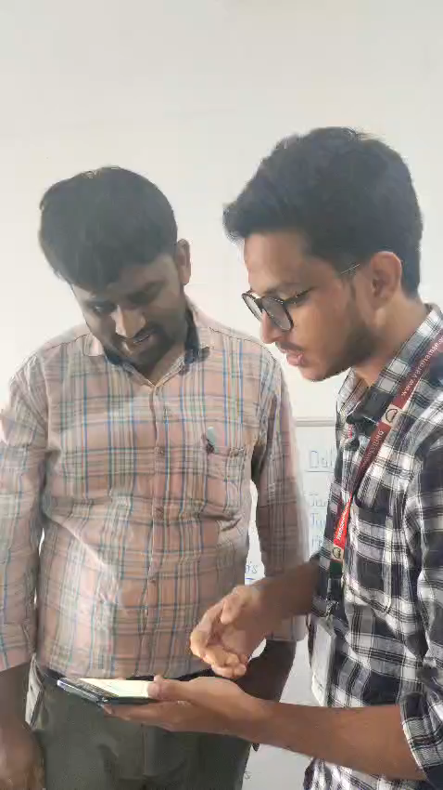
A8024 - Product Realization
2 minutes Video :

Slide 15
A8024 - Product Realization
Conclusion :
TOGOTU goes beyond being a tour guide app. It enhances travel by giving quick insights into local areas, real-time updates, secure features, interactive maps, and connecting users with local guides. It ensures safe, informative, and enjoyable journeys for all travelers.
Our commitment is to transform the TOGOTU App into the ultimate travel companion worldwide. Whether embarking on a solo adventure or a family vacation, our goal is to ignite inspiration and provide invaluable guidance, ensuring each trip becomes a meaningful and unforgettable experience for all travelers.

Slide 16
A8024 - Product Realization
References:
[1] Maulik, Baivab, et al. "Design and implementation of virtual tour guide app." 2022 International Conference on Advanced Computing Technologies and Applications (ICACTA). IEEE, 2022.
[2] Lee, Seok Ju, et al. "Autonomous tour guide robot by using ultrasonic range sensors and QR code recognition in indoor environment." IEEE International Conference on Electro/Information Technology. IEEE, 2014.
[3] Liu, Yizhen, et al. "Design and Implementation of Intelligent Tour Guide Application System." 2022 IEEE 10th Joint International Information Technology and Artificial Intelligence Conference (ITAIC). Vol. 10. IEEE, 2022.
[4] Kondlo, Aphile, et al. "Self-Guided Virtual Tour Using Augmented Reality." 2020 ITU Kaleidoscope: Industry-Driven Digital Transformation (ITU K). IEEE, 2020.
[5] Cui, Binyue, et al. "Smart mobile APP of museum—Investigations and design for local culture protection." 2017 12th International Conference on Computer Science and Education (ICCSE). IEEE, 2017.

Slide 17
A8024 - Product Realization
Any Questions/Discussions ???

Slide 18
A8024 - Product Realization
Thank You !!!

